Slide 1
BACKEND LAYERED ARCHITECTURE
Web Layer
Business Layer
Persistence Layer
Database

Slide 2
ORM FRAMEWORK
ORM frameworks allow developers to interact with relational databases using object-oriented programming by mapping tables to classes and rows to objects.
It allows to eliminate Boilerplate Code
. NET
Java
Entity Framework
Dapper
NHibernate
Spring Data JPA
Hibernate

Slide 3
ENTITY FRAMEWORK
Open-source, light weight, extensible ORM for .NET
It maps the .NET objects to Database Table
Key Features
Installation
Microsoft.EntityFrameworkCore.SqlServer
Install-Package Microsoft.EntityFrameworkCore.SqlServer
Microsoft.EntityFrameworkCore.Tools
Install-Package Microsoft.EntityFrameworkCore.Tools
Cross-Platform : Runs on Windows, Linux, macOS
Database Support : SQL Server, MySQL, SQL Lite, Postgre SQL
LINQ Queries : Type-safe Querying

Slide 4
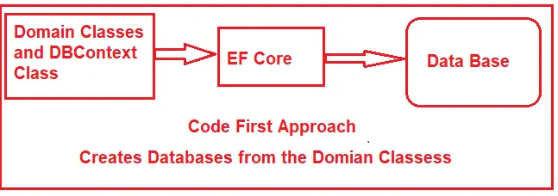
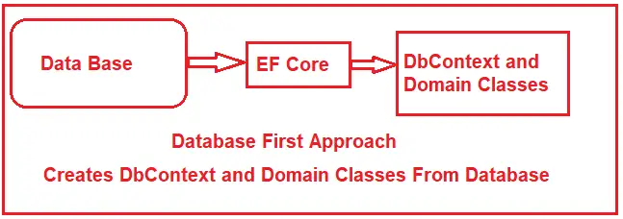
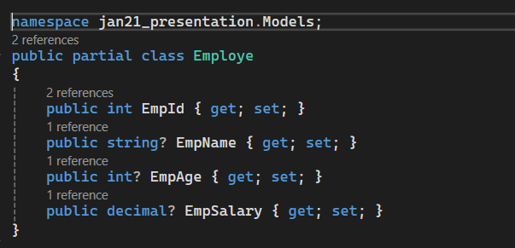
EF Core Development Approaches
Code-First-Approach
Database-First-Approach
Scaffold-DbContext <Connection-String> <Database Provider> –o Models -f
Model

Slide 5
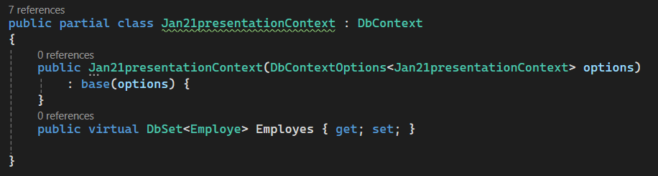
DbContext
It is the primary class that is responsible to interact with database, and acts like a bridge between entity class and Database
Key Features
i. Tracks local copy of data
ii. Manage DB Connections, Perform CURD , tracks Entity states (Added,Modified,Deleted,Unchanged,Detached)
iii. Translates LINQ
Methods Provided by DBContext class
SaveChanges()
RemoveRange()
Find()
Remove()
Update()
Set<Entity>()
AddRange()
Add()
Configuring DbContext

Slide 6
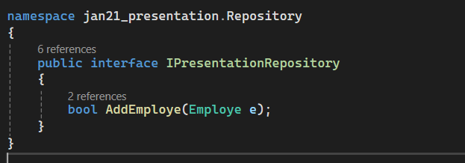
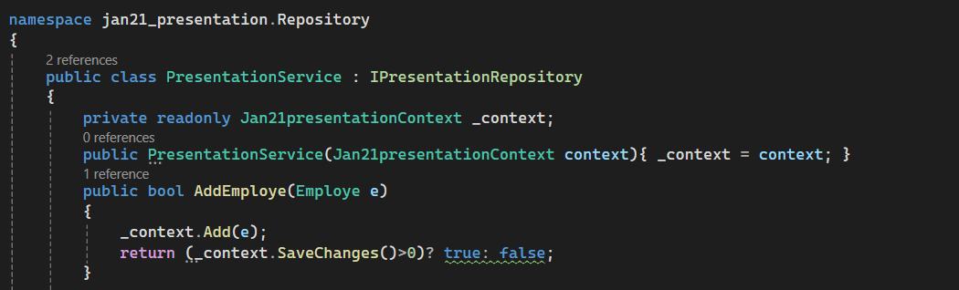
Using DbContext with Dependency Injection

Slide 7
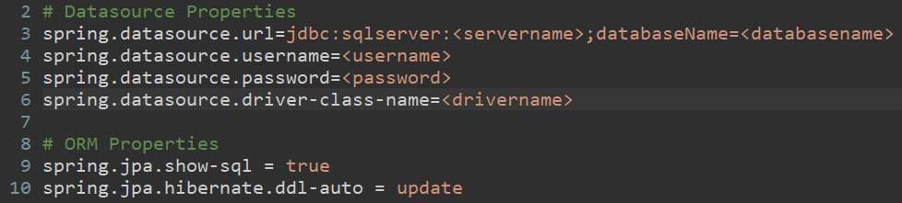
SPRING DATA JPA
Open-source, light weight, extensible ORM for Java
It maps the Java objects to Database Table
Simplifies data access and manipulation.
Key Features
Repository pattern for data access
Automatic implementation of repository interfaces
JPQL for querying
Installation
Add Starters
i. spring-boot-starter-data-jpa
ii. Database Driver (Sql Server, MySQL,Oracle, …etc)
iii. lombok
Add Datasource Properties & ORM Properties
we need to add the below shown properties in application.properties or application.yml files

Slide 8
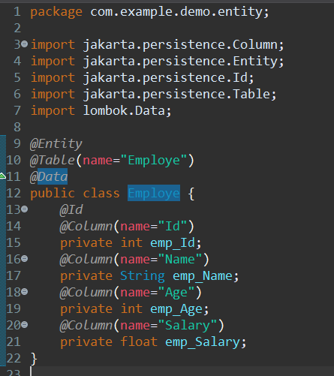
Entity
Repository Interfaces
JPA provided repository interfaces to perform Curd Operations
For Every DB table we will create one Repository interface by extending Repository Interfaces
Types :-
CRUD Repository
JPA Repository

Slide 9
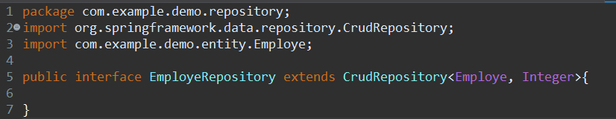
Crud Repository
This Repository is used to perform only CRUD operations on entities
Methods Provided by CRUD Repository
Count()
findAll()
Save(entity)
deleteAll()
deleteAllById(pks)
findAllById(pks)
SaveAll(entites)
deleteById(pk)
delete(entity)
deleteAll(entites)
findById(pk)
existsById(pk)

Slide 10
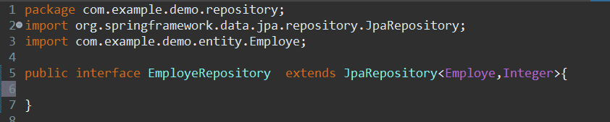
Jpa Repository
This Repository is used to perform CRUD + Pagination + Sorting + QBE (Query By Example)
Pagination
The process of dividing all the records into multiple pages is called as Pagination
Data will be displayed based on below 2 conditions
PAGE NUMBER (User landed on which page)
PAGE SIZE (How many records should be displayed in single page)
Sorting
Sorting is used to sort the records either in ascending or in descending order
Query By Example
To implement Dynamic Search Option we can use QBE concept
It is used to prepare the query dynamically

